Slide 1
Option 1
ASMR Ambience for Studying

Slide 2
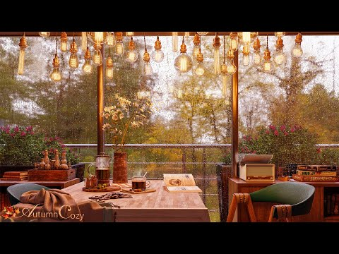
https://www.youtube.com/watch?v=mkgylOJSdhE&t=5s

Slide 3
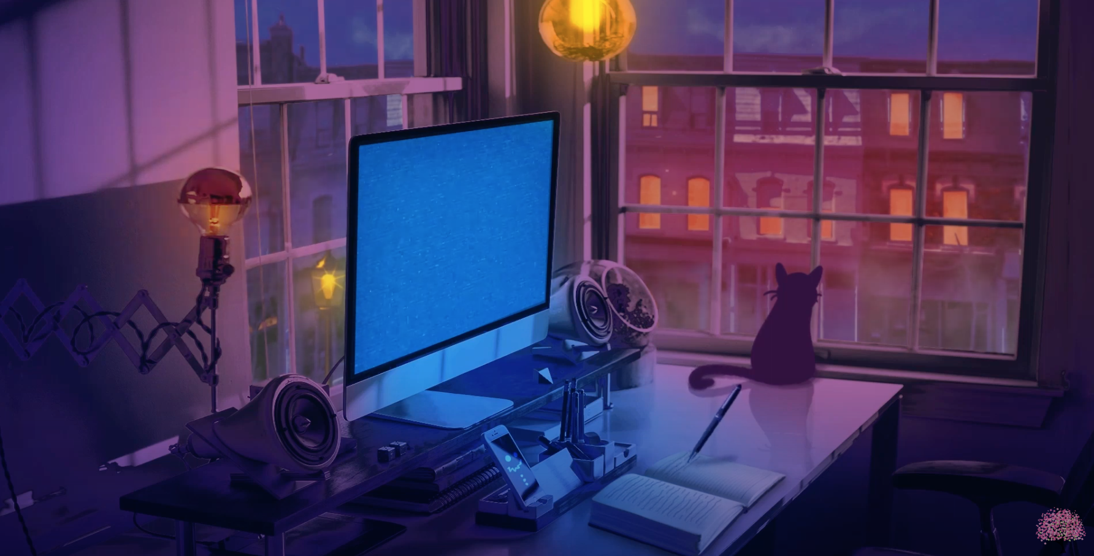
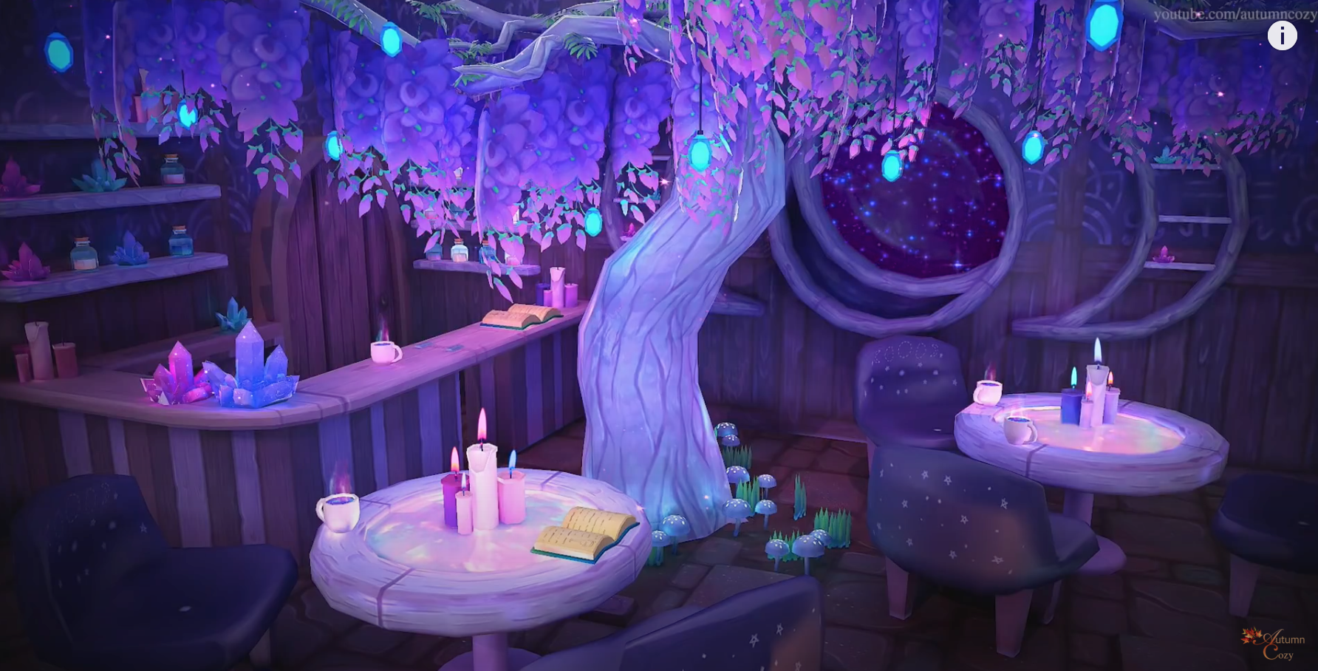
Visual References

Slide 4
Option 1:
Window
Day going by/light changing
Birds chirping, faint music
Option 1
Option 2
Option 3
Option 2:
Garden
Plants and trees
Wind blowing through leaves
Option 3:
Desk
laptop/study set up
Typing, pages turning

Slide 5

Option 1
Incorporate sound libraries
Peaceful animations
Calming color palette
Relaxing music and sound effects

Slide 6
Option 2
Change the Seasons, Decorate a Garden for Spring

Slide 7
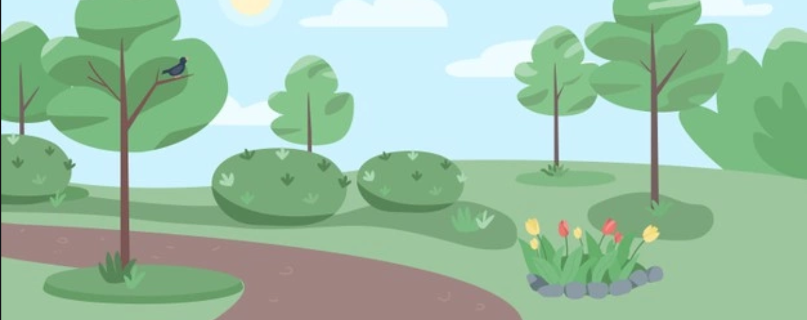

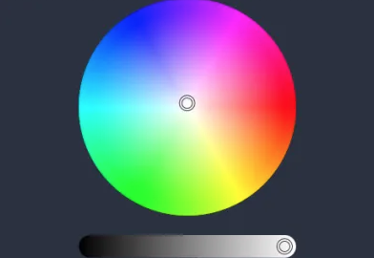

Create a background scene
Cycle through different items to stamp to the scene with the key press
Choose a color for the item with the tool bar

Slide 8
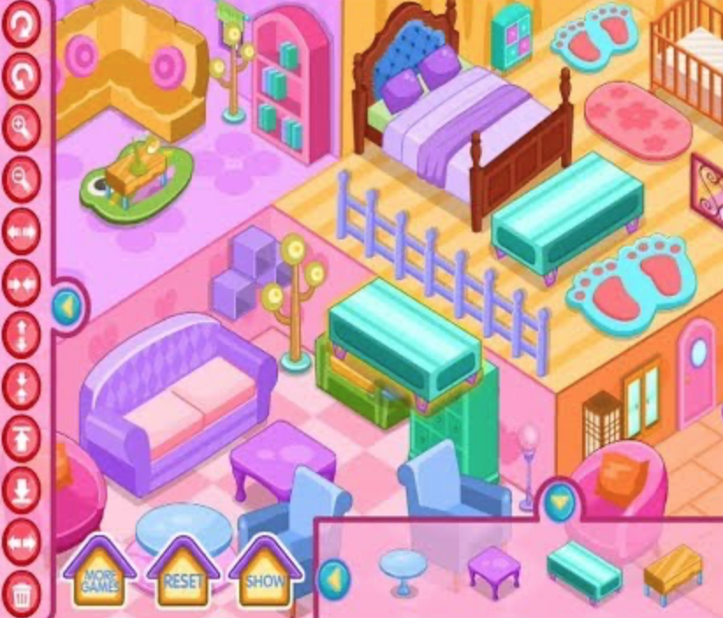
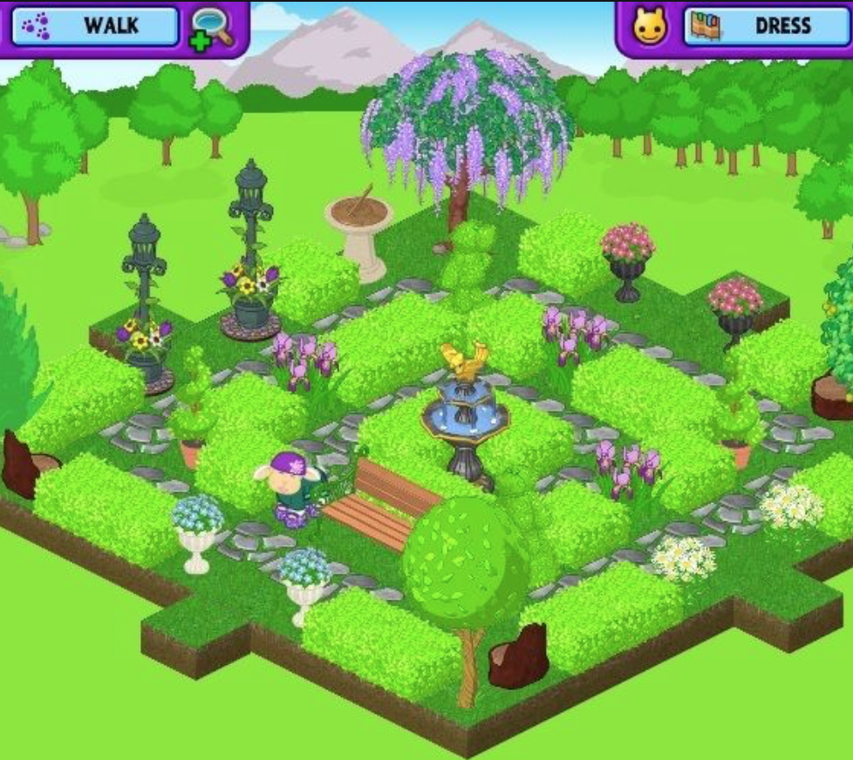
Inspiration
Home Decor Games
Webkinz

Slide 9
Option 3
Space Invaders Style Game

Slide 10

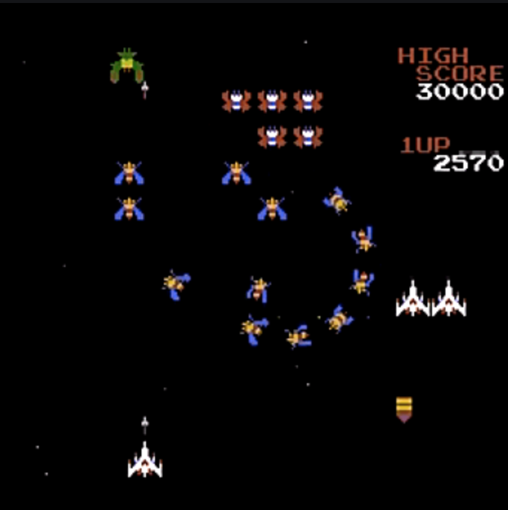


Space Invaders concept with an updated aesthetic
Shooting flowers
Bright colors
Plant theme
Move the mouse to change the location on X axis
Click to shoot a flower

